Slide 1









ECO WARRIORS
Protection of endangered species
Presented by DTIL Group Number 16

Slide 2

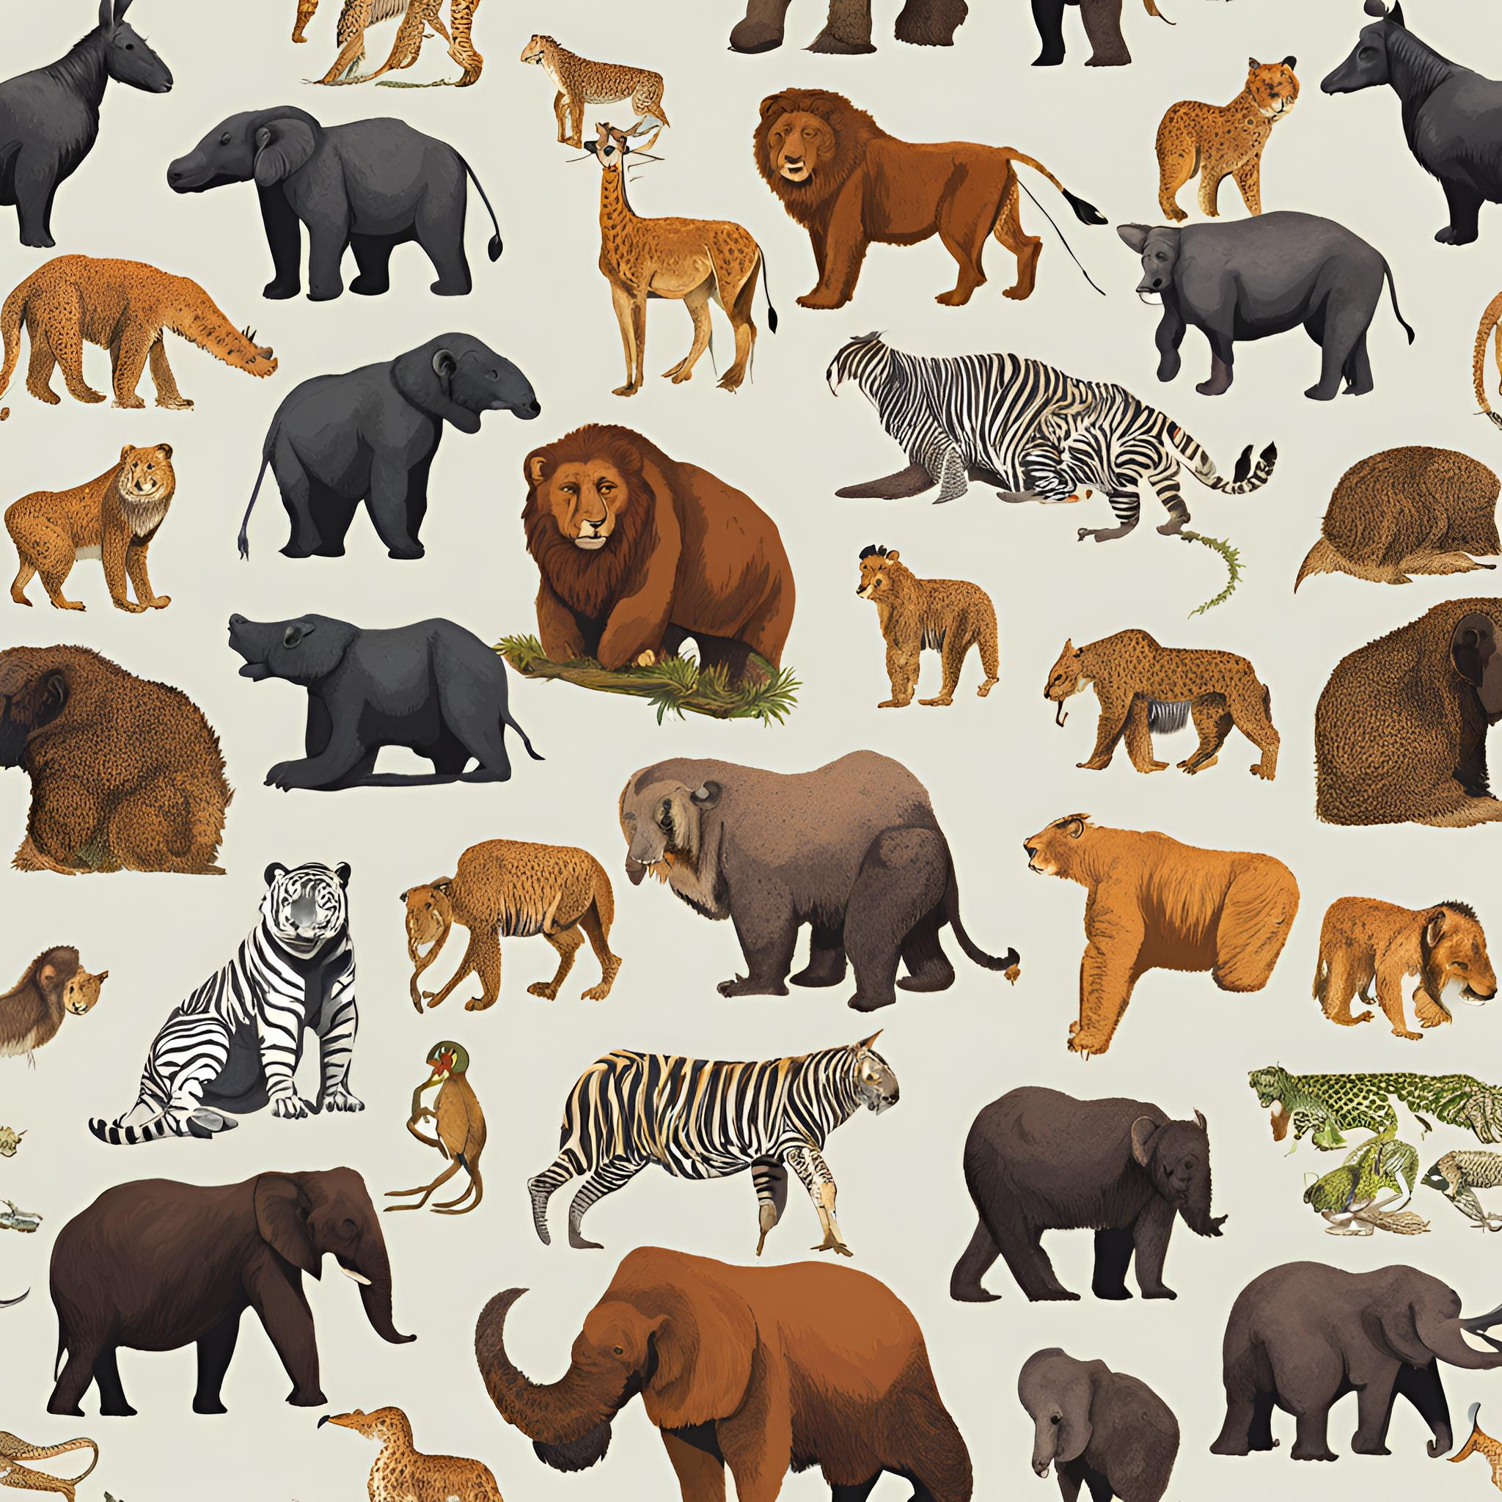

GROUP MEMBERS
Group leader : Ayush Deore
Group members : Vedant Admane
Sarthak Patil
Smruti Gorde
Vedanti Vahadne
Sanskruti Madhawai

Slide 3

About the Project
Aims to conserve, protect and restore their populations of animals ,plant ,and other organisms at risk of extinction
The goal is to maintain biodiversity, ensuring healthy ecosystem and preserving natural balance of environment for the safety of planet and upcoming generation

Slide 4
OVERVIEW
Why to select this project
Importance of conservation
Protecting endangered species is important for the health of our planet and to secure the future for the ecosystem and people. At IFAW our mission is to build a future where animals and people can thrive together.
Relevant to real word issues
When species become endangered it is a sign that the ecosystem is slowly falling , apart each species that is lost triggers the loss of other spaces within its ecosystem humans depend on healthy ecosystem to purify our environment.
Emotional resonance
When a species becomes endangered it is sign-a Red flag something is breaking down or had already broken down you must depend on healthy ecosystem and when these system start unreweling as evidence by accelerating rate of species endangerment it is called for humans to pay attention
Lastly it's important to protect endangered species for ethical reasons. we should appreciate and conserve all life on our planet ,not just because it has benefits for human being but also because we all are dependent on each other

Slide 5
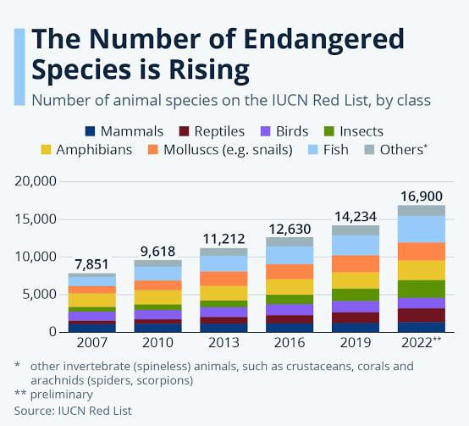

Slide 6

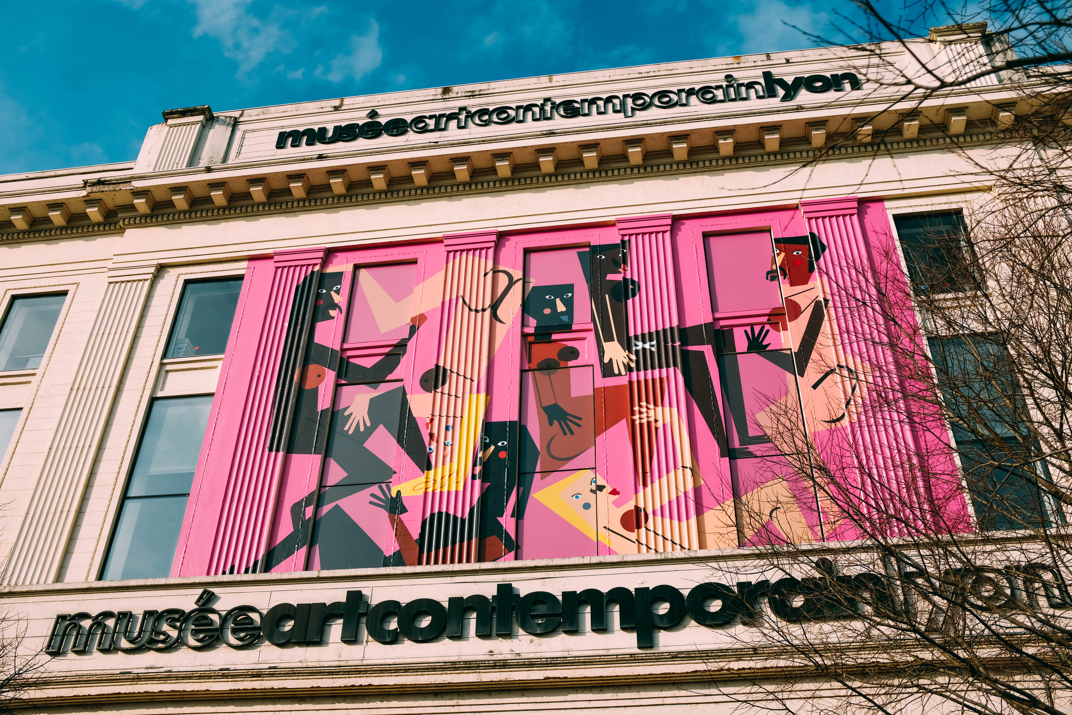
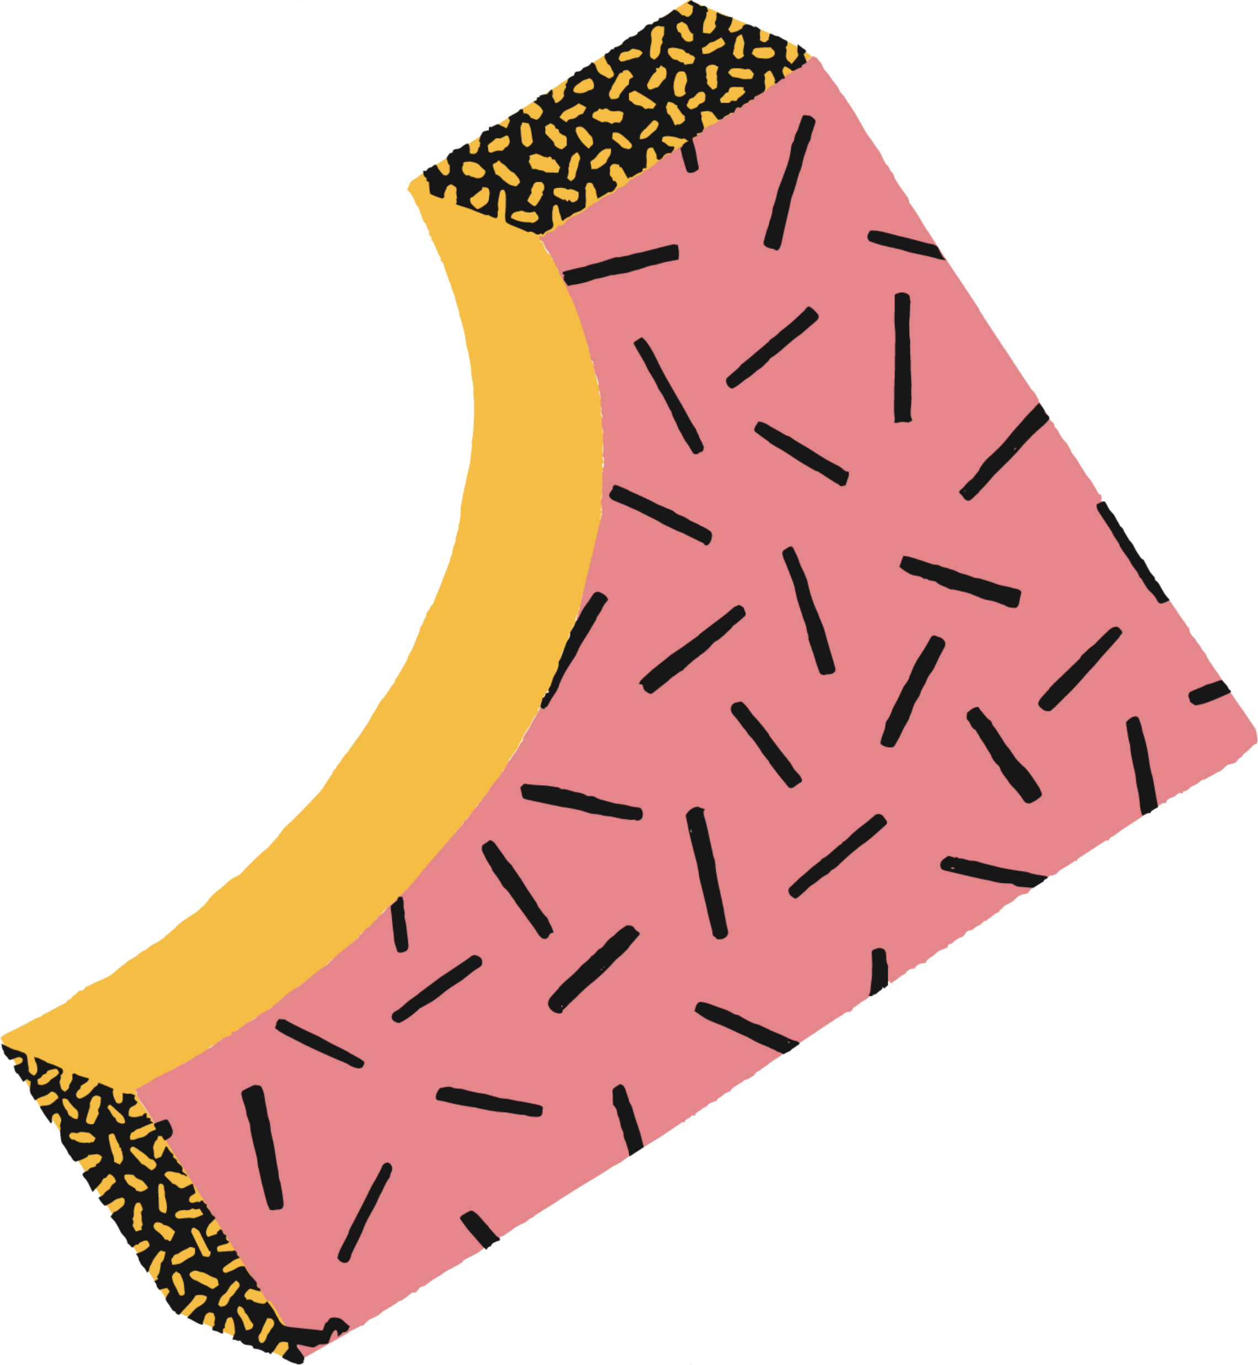
VISUALIZATION
visualization of the project will be after 5 years as in consideration of unlimited resources

Slide 7
Project: Endangered Species Protection
Plant Protection:
Greenhouse : A controlled greenhouse environment will be created to protect and nurture endangered plants.
Drip Irrigation : A drip irrigation system will ensure efficient and targeted water delivery to the plants.
Growth Hormone Injection : Growth hormones will be injected into the plants to promote their growth and development.
Research Lab : A research laboratory will be established to study the endangered plants and develop methods for their conservation.
Fertilizer Store : A fertilizer store will be maintained to provide essential nutrients to the plants.
Regular soil testing: Conduct periodic tests to assess soil nutrient levels, pH, and potential contaminants
Ex-situ conservation : Explore ex-situ conservation techniques, such as captive breeding
Monitoring Lab: Controlling all CCTV cameras and it's footage
Water filtration : Implement a filtration system to ensure the pond water is clean and free of contaminants.
Artificial lighting: Provide appropriate artificial lighting to mimic natural daylight conditions for plants and animals, especially during winter months.

Slide 8
Animal Protection
Neckband with Sensors: Each animal will wear a neckband equipped with sensors to monitor their health, location, and behavior.
Vaccination and Germ Cell Collection: The neckband will be connected to a system that can administer vaccinations and collect germ cells for preservation.
Software Integration : The neckband will be linked to software that tracks animal health, location, and behavior.
Artificial Fertility Center : A center will be established to facilitate artificial fertilization using the collected germ cells.
Protected Compound Area: A secure area will be created to house and protect the endangered animals.
Hospital and Ambulance : A hospital and ambulance service will be available to provide immediate medical attention to the animals.
Water filtration : Implement a filtration system to ensure the pond water is clean and free of contaminants.
Overall, this project aims to create a comprehensive ecosystem for the protection of endangered species. By combining technology, medical care, and controlled environments, we can significantly improve the chances of survival for these vulnerable animals and plants.

Slide 9
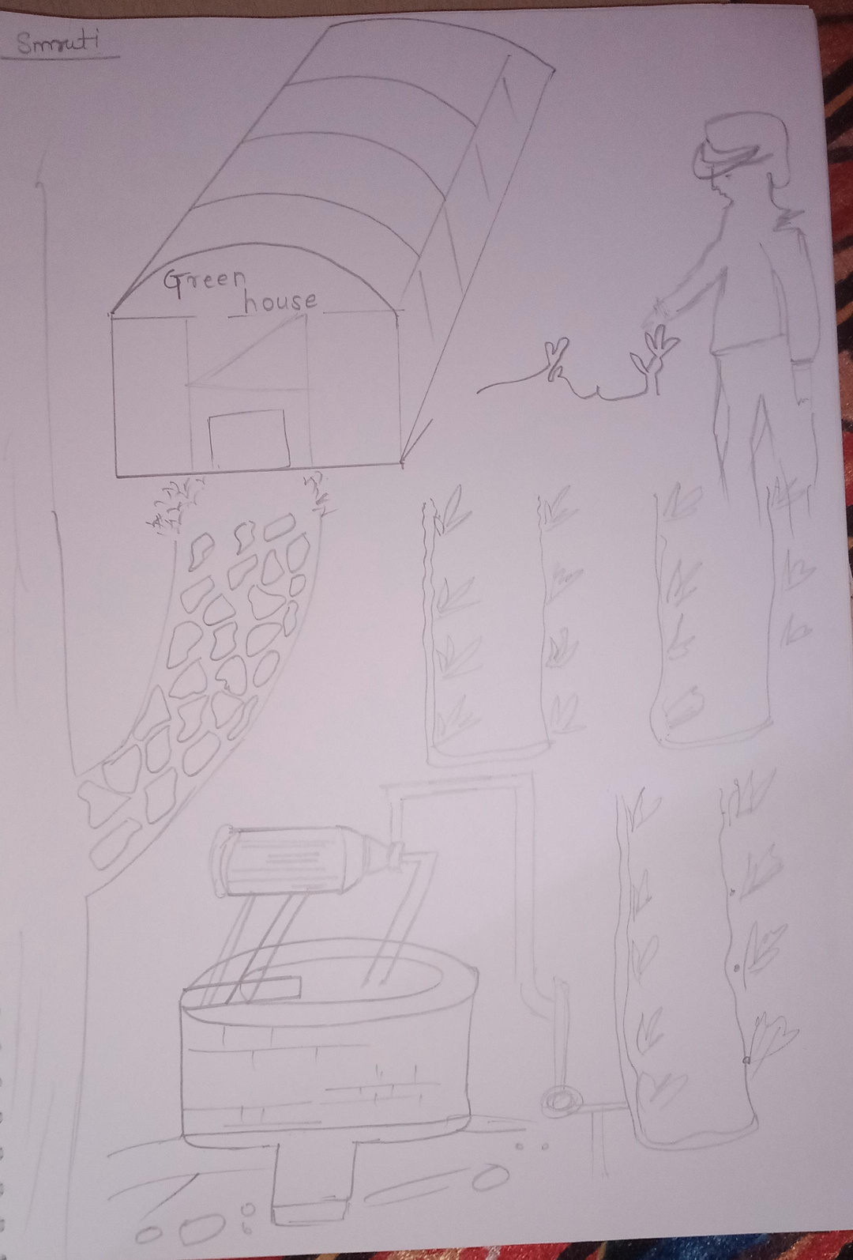
Smruti’s visualization

Slide 10
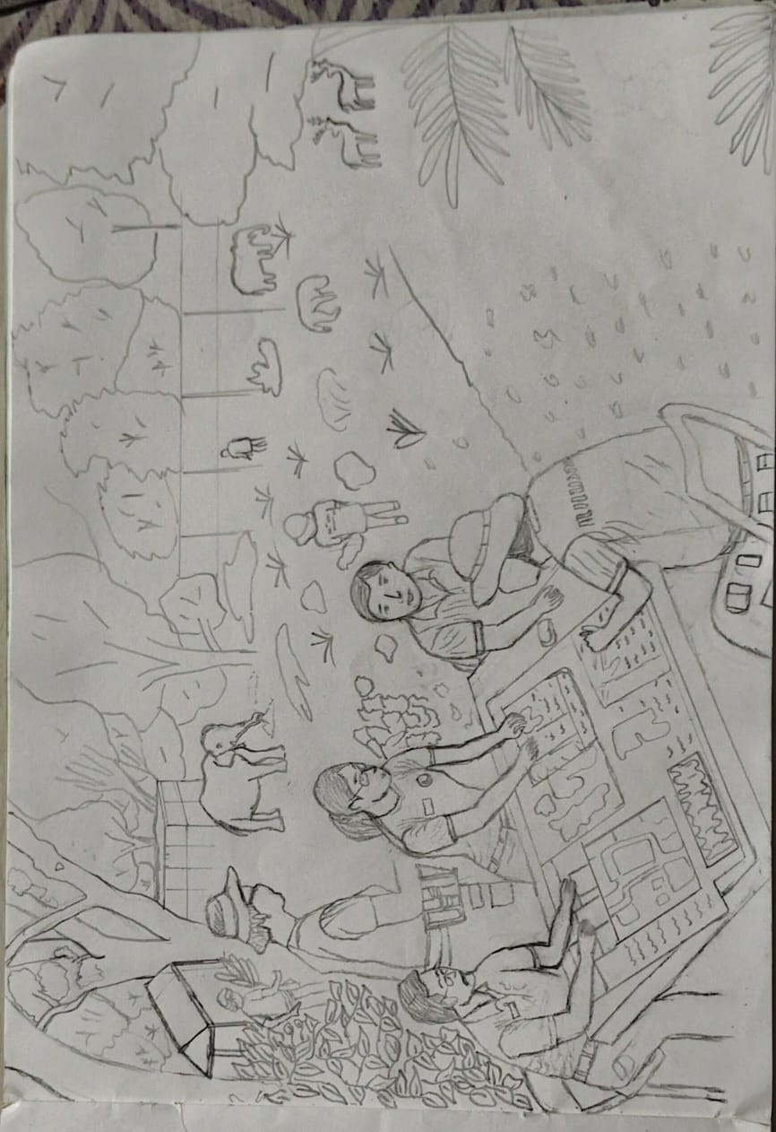
sanskruti’s visualization

Slide 11
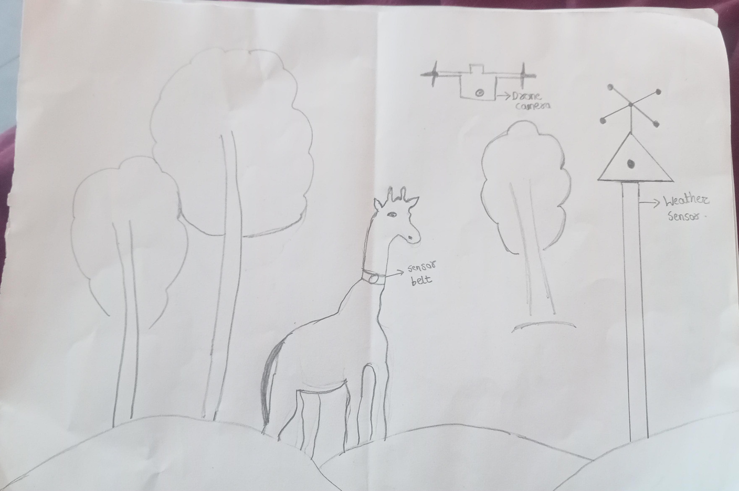
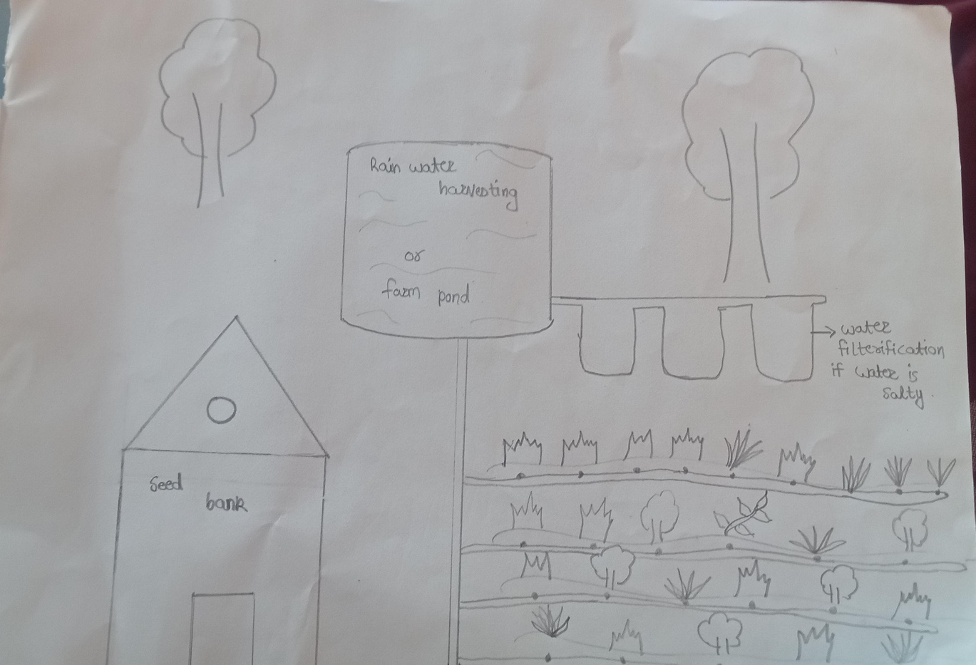
Vedanti’s visualization

Slide 12
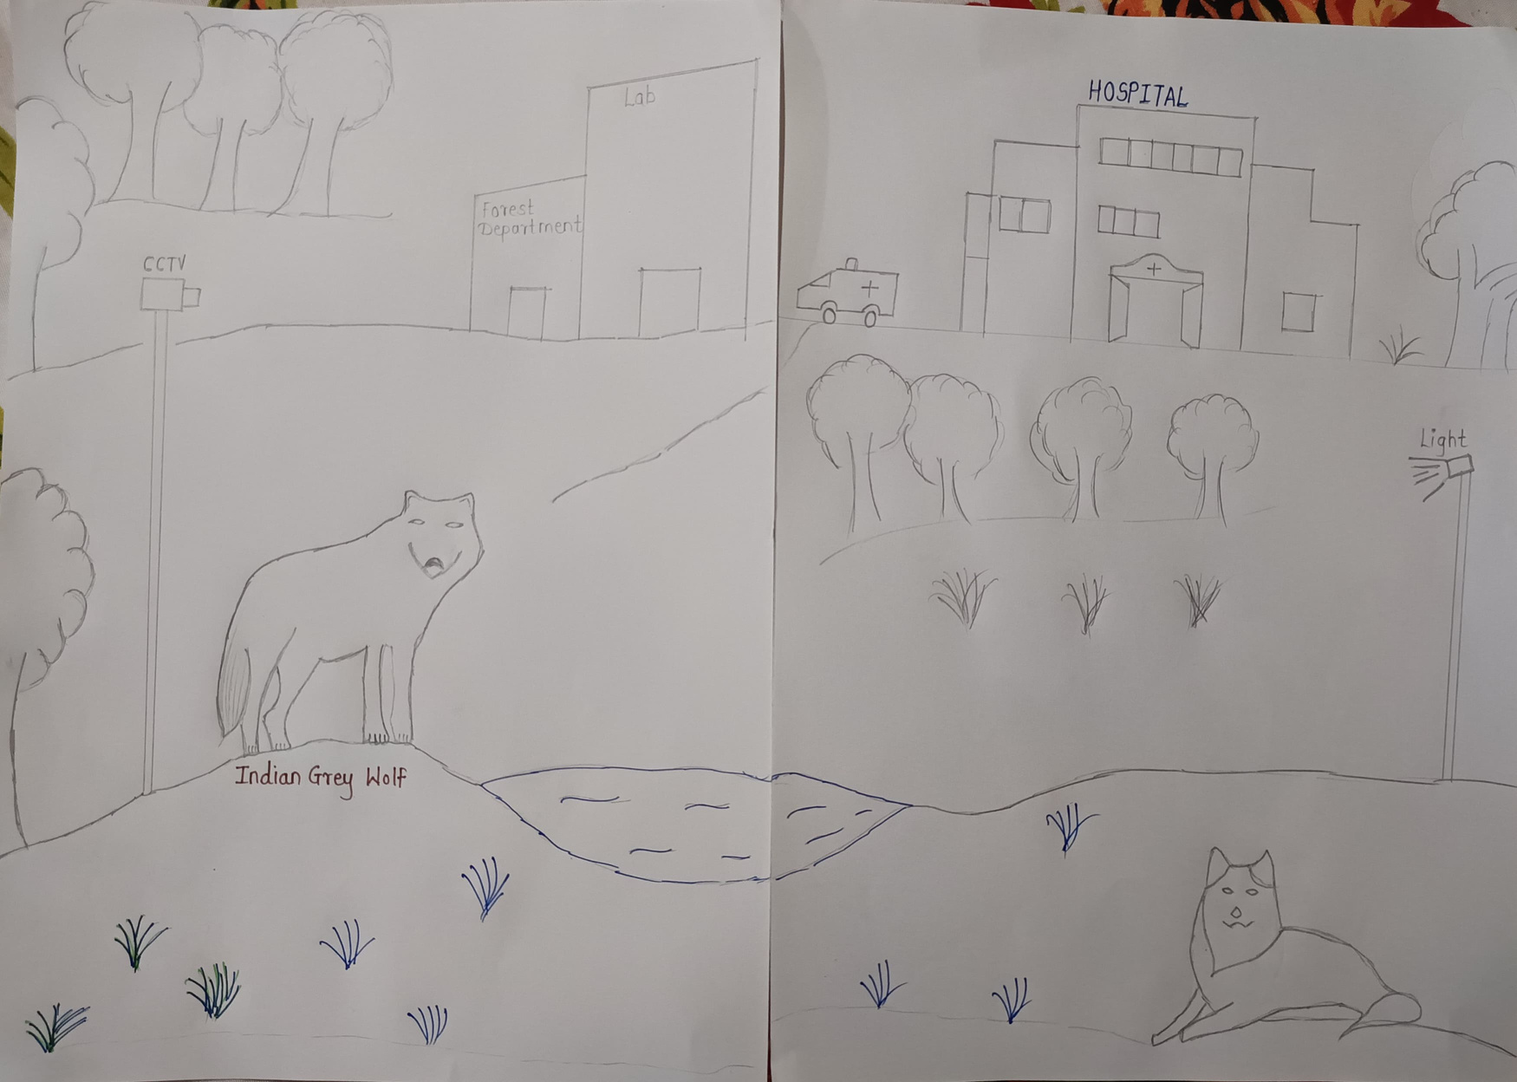
Ayush’s visualization

Slide 13
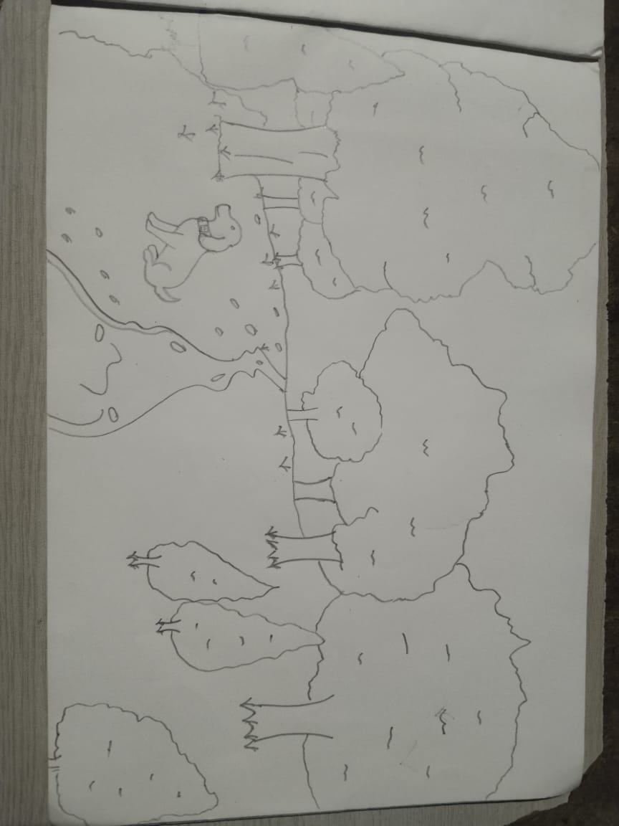
Vedant’s visualization

Slide 14
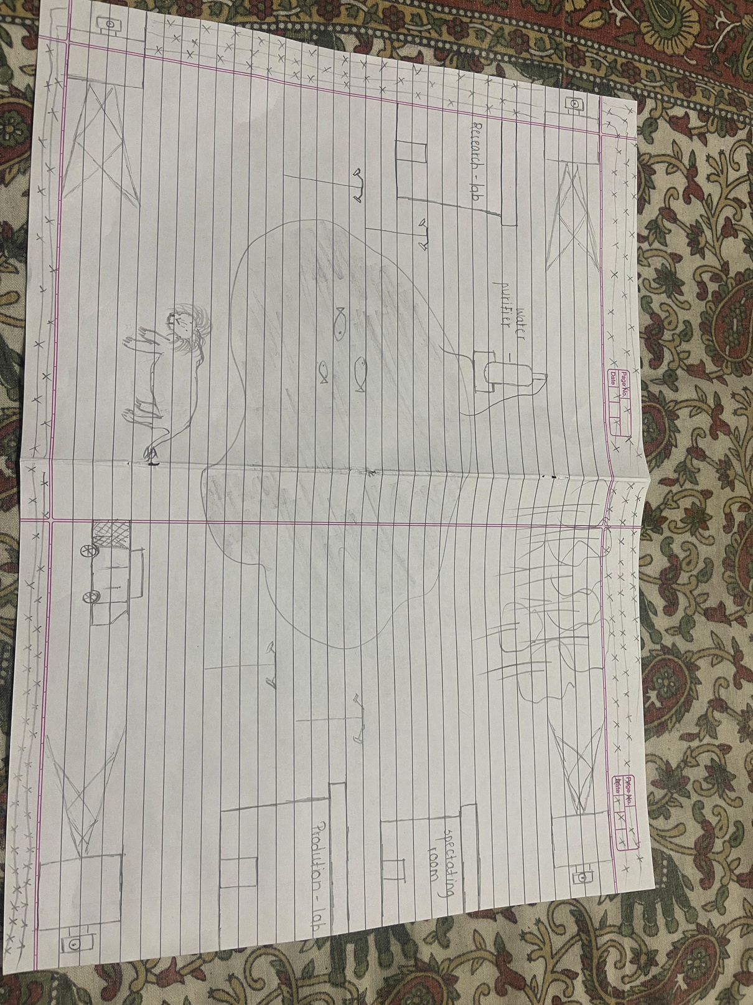
Sarthak’visualization

Slide 15
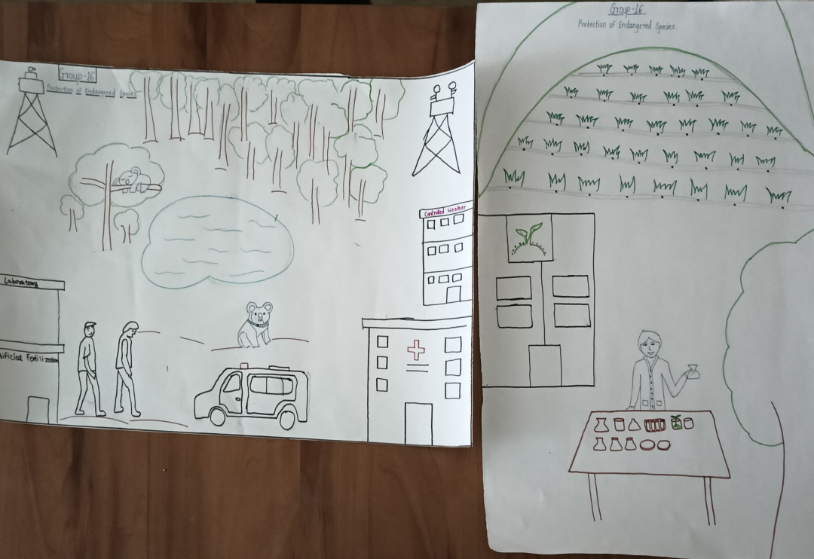
Final visualization

Slide 16


Persona construction
What is persona construction?
persona construction is the process of creating a detailed summary of a person ,that represent the different type of users , audiences product or a service you're trying to provide.
In this activity we have to find our end user which will be helpful for our project in future . After finding the end users we have to create persona on their basis of their life and how will they be helpful in our project as a end user.

Slide 17
Persona
(research student)
background
motivation
A student who wants to be a scientist to save endangered species.
Who lived in a big town.
Learned to love nature by going camping with
family and learning about it in school.
Wants to protect wildlife.
Motivated by wildlife documentaries.
passion through spending time in nature
Encouraged by Family and friend's friends support. Inspired by renewed conservationists.
doubts/fears
Worried about knowing enough skills for job.
Limited job opportunities in conservation Field.
Not sure if bel she can really help Species.
Scared of having trouble in finding information
Worried about endangered species faced by the
challenges faced
Didn't have much experience of knowledge about how to do research.
Balancing, coursework and research projects.
didn't have enough money to go on research trips or meetings.
Couldn't find a good teacher to help them.
Struggles with applying theoretical
aspiration
contribute to significant conservation projects know more about species in danger and how to protect them
Build a strong professional network.
Expand knowledge about endangered species Work as a conservation.
construct a story while explaining the persona to your peers and document the insights
Ria is a student who wants to save animals and plants. She grew up in a big city but loves nature. She's learning to be a scientist who protects endangered species. She wants to work with animals and plants in the real world but is worried about finding a job and having enough knowledge. She hopes to help save lots of animals and plants.

Slide 18
Persona
(local community
Background
Motivation
Resides in rural area near a protected area or wildlife sanctuary.
Dependent on natural resources for livelihood like agriculture, fishing, etc.
Strong cultural connection to the land and wildlife.
Limited formal education but possesses traditional ecological knowledge.
Desire to protect the environment for future generations.
Maintain cultural and spiritual connection to the land.
Improve livelihood through sustainable practices.
Access to better education and healthcare for the community.
Doubts/fears
Uncertainty about the benefits of conservation efforts.
Concern about job loss due to conservation initiatives.
Fear of displacement from ancestral lands.
Lack of trust in government and conservation organizations.
Challenges faced
Loss of livelihood due to declining wildlife populations or habitat degradation.
Damage to crops and property caused by wildlife.
Lack of access to basic amenities and healthcare.
Limited opportunities for income generation.
Lack of awareness about conservation and sustainable practices.
Aspiration
Improved living conditions for the community.
Sustainable livelihood opportunities.
Access to quality education and healthcare.
Recognition and appreciation of traditional knowledge.
Construct a story while explaining the persona to your peers and document the insights
Maya is from a local communities living near protected areas often depend on natural resources for their livelihoods. They face challenges such as habitat loss, human-wildlife conflicts, and limited access to resources. While motivated to protect the environment, they worry about job losses and displacement. Their aspirations include improved living conditions, sustainable livelihoods, and peaceful coexistence with wildlife. Understanding these perspectives is essential for effective conservation initiatives that involve local communities as partners.

Slide 19
Persona
(eco tourist)
Background
Motivation
Urban Resident with a growing appreciation for nature.
Enjoy travelling and exploring new cultures.
Concerned about environmental
Seeks environmental and want's to feel a Connection to the nature.
Move out of daily routine and connected with nature.
Learn about different-different cultures and it’s eco-system across the world.
Contribution to conservation efforts through tourism.
Doubt/fears
Fear of getting robbed while travelling across the world.
Safety in remote area on visiting.
Worried about the ethical significance of wildlife tourism. Hesitation about spending money on eco-tourism
Challenges faced
Balancing the work life with the travelling.
Concerns about the safety and comfort in unfamiliar places.
Finding the perfect location for next travelling adventure.
Uncertainty about the places of visit.
Lack of funding for travelling.
Aspiration
Experience of the vast and diverse ecosystem and wild-life.
Capture real images of endangered species.
Learning new things through travelling.
Construct a story while explaining the persona to your peers and document the insights
Aryan, an eco-tourist, who is quiet close to nature and feels a connection with it. Aryan is concerned about environment and endangered animals, and want's to contribute for conservation of nature. He travels and tries to help the environment while learning about it, and sharing his knowledge with others. Understanding the importance of the nature, Aryan trios his best to protect environment as much as be can.

Slide 20









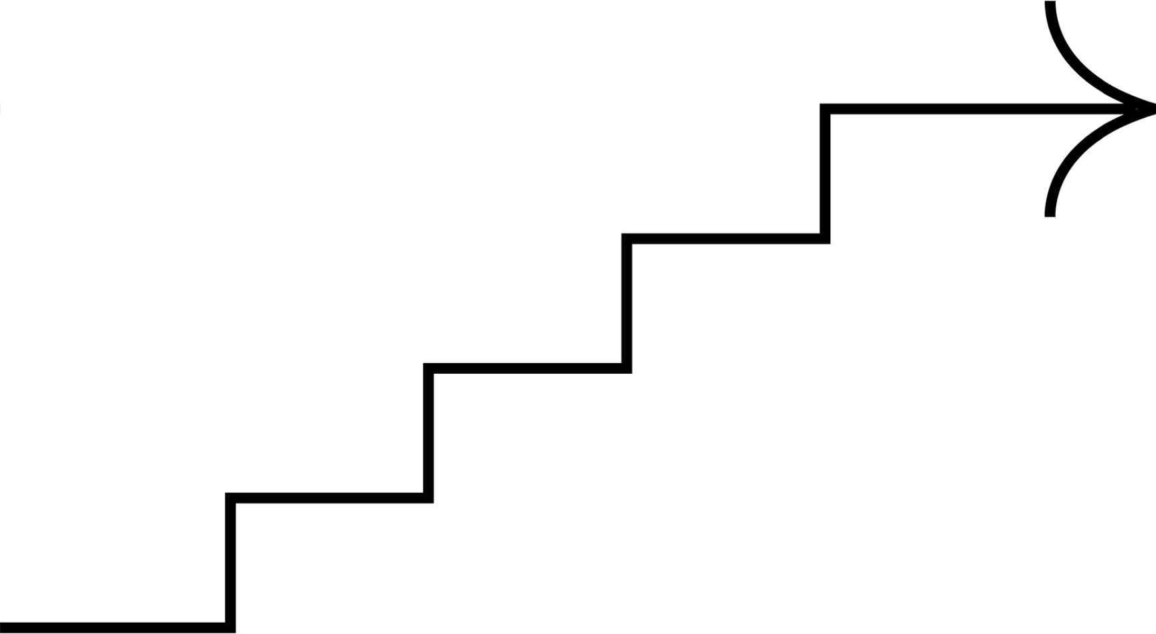

Mind mapping
September 11, 2024
Mind mapping
key words
categorization

Slide 21

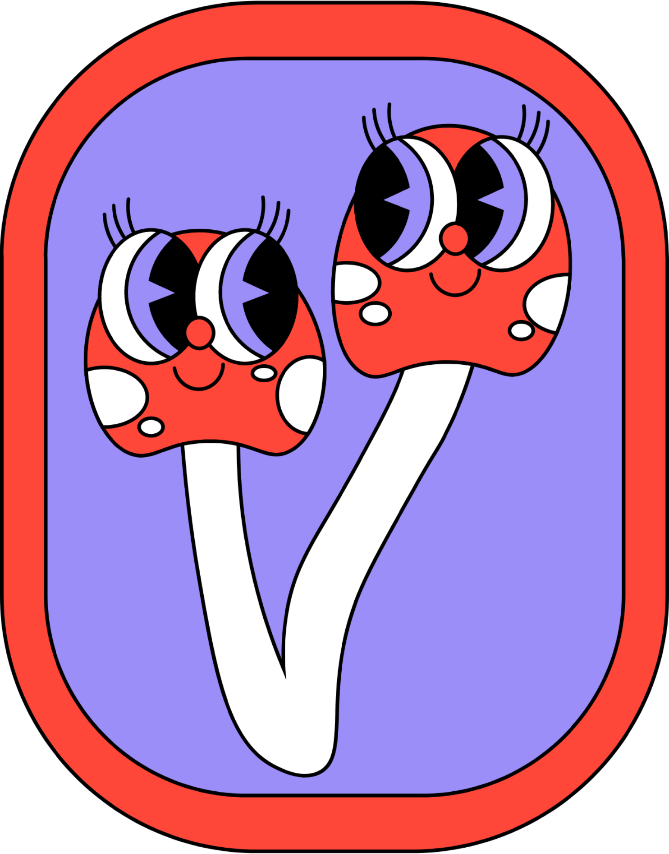
Mind mapping is a visual tool that used to organize information and ideas in a non-linear way. It's a visual brainstorming session where you start with a central topic and branch out with related ideas.
The idea that each members have are collected and sorted into group or sections .As every person has a way of thinking ,it helps in creating new ideas .
What is Mind Mapping

Slide 22
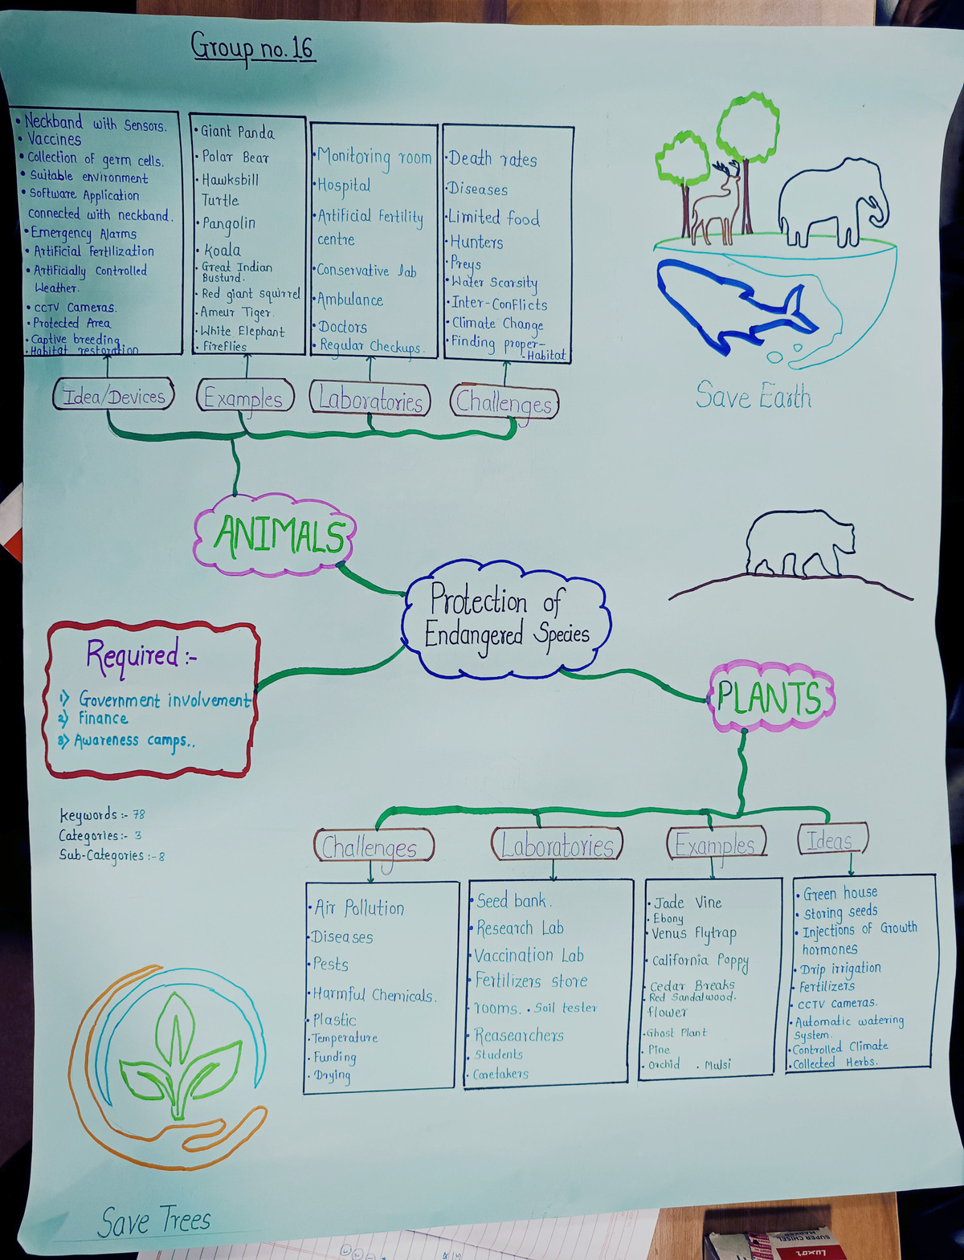
mind mapping

Slide 23


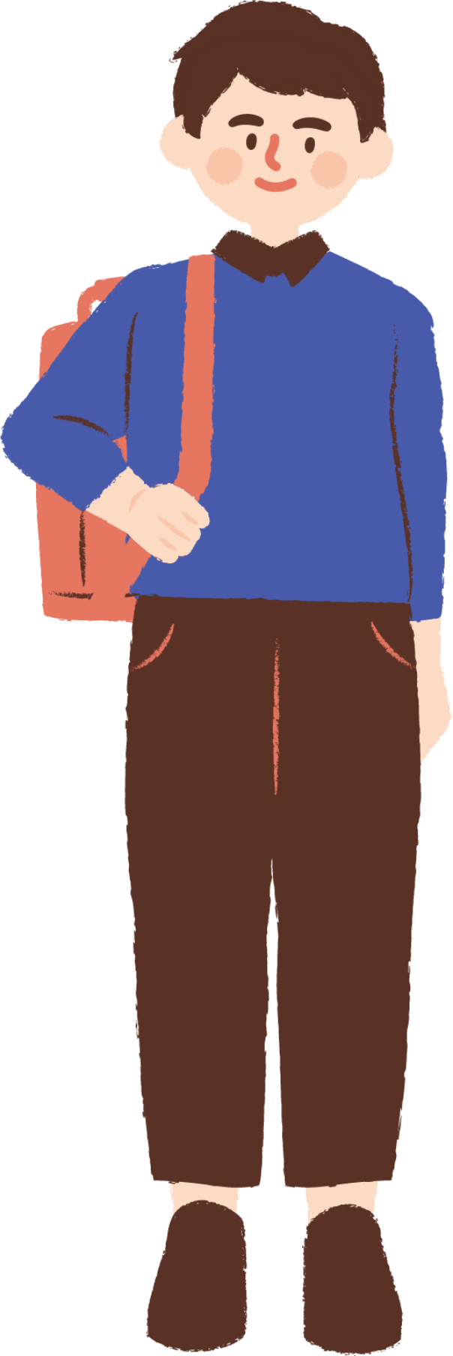
Wh- Questions
Applying the 5W1H Method to Endangered Species Protection.
The 5W1H method (Who, What, When, Where, Why, and How) is a powerful tool for planning and problem-solving. I've applied it to the complex issue of endangered species protection to ensure a comprehensive and effective approach.
.

Slide 24

Why?
idea/devices
Why are growth hormones or fertilizers used in agriculture?
Why are CCTV cameras used
Why are suitable environments created for captive breeding?
Challenges faced
Why is air pollution increasing?
Why are disease rates rising?
Why are pests and harmful chemicals becoming more widespread?
laborotary
Why are soil testers used in laboratories?
Why are ambulances essential for emergency medical services?
Why is a fertilizer store essential for agricultural practices?
Examples
Why is the Venus Flytrap facing threats in its natural habitat?
Why is the Giant Panda's bamboo diet a concern for its survival?
Why are Hawksbill Turtles targeted for their shells?

Slide 25
Who?
idea/devices
Who would benefit from using these agricultural techniques?
Who would collect germ cells for preservation or genetic research?
Who would wear a neckband with sensors
Challenges faced
Who is contributing to air pollution, diseases, and plastic waste?
Who can help protect endangered species and their habitats?
Who can benefit from sustainable practices and a healthy planet?
laboratary
Who manages the seed bank?
Who conducts the vaccinations
Who works in the hospital?
Examples
Who are the indigenous communities that rely on these animals for their livelihoods?
Who is responsible for protecting these endangered species?
Who are the individuals working to conserve these animals?

Slide 26
What?
Idea / devices
What is the overall theme or purpose of the idea or devices
What role do vaccines play in this project
What kind of data would the software application connected to the neckband collect and process?
Labrotary
What are the functions of the artificial fertility center
What are the essential components of a greenhouse
What is the role of the monitoring room in the system
Examples & Requirements
What are the examples of endangered animals
What are the requirements for this project.
What are the examples of endangered plant species.
Challenges faced
What are some of the major challenges faced by organisms?
What role do diseases play in the survival of organisms?
What are the effects of environmental degradation?.

Slide 27
When?
Idea / devices
When are herbs typically harvested and processed?
When should software applications be updated or upgraded?
When is the best time for artificial fertilization or weather control to be implemented?
Laboratories
When are regular checkups scheduled?
When are tests conducted in the conservative lab?
When are researchers conducting experiments in the research lab?
Examples & Requirements
When were these species first listed as endangered?
When did these species start facing significant threats to their survival?
When were conservation efforts initiated to protect these species?.
Challenges faced
When will we see significant progress in addressing these issues?
When will we see the benefits of sustainable practices
When will funding for environmental initiatives increase?

Slide 28
Where?
Idea / devices
Where are effective environmental solutions being implemented?
Where is air pollution highest?
Where are disease outbreaks most common?
Labrotary
Where are the laboratories located?
Where are the soil testing facilities?
Where do researchers and students typically work?
Examples & Requirements
Where are these species found in their natural habitats?
Where are the primary threats to these species located?
Where are the most successful conservation efforts taking place?
.
Challenges faced
Where are effective environmental solutions being implemented?
Where is air pollution highest?
Where are disease outbreaks most common?

Slide 29
How?
Idea / devices
How can protected areas be managed and maintained
How can a greenhouse be constructed or maintained?
How can software applications be developed to track wildlife data?
Labs
How is the seed bank managed?
How are fertility treatments performed?
How are animals diagnosed and treated in the hospital?
Examples & Requirements
How are conservationists working to protect these species?
How are these species being affected by climate change?
* How are human activities contributing to the decline of these species?
Challenges faced
How can we prevent the spread of diseases?
How can we limit the use of harmful chemicals?
How can individuals and communities contribute to environmental conservation?

Slide 30






Thank you!
For giving us such wonderful chance to represent ourself!!!!

